Slide 1
Module 19
Measuring and Delivering Marketing Performance
By: Dr Shahinaz Abdellatif

Slide 2
Objective of this session
To examine how to design strategic control systems
To consider design decisions for marketing performance measurement

Slide 3
The Control Process
Setting standards of performance
Specifying the necessary feedback data
Obtaining the needed control data
Evaluating feedback data -- explaining gap
between actual and given standards of performance
Taking corrective action
Notes:
2

Slide 4
1- Setting standard for performance
These standards derive largely from the objectives and strategies set forth at the SBU and individual product-market entry level. They generate a series of performance expectations for profitability (return on equity or return on assets managed), market share, and sales.
At the product-market level, standards of performance include sales and market-share determinants such as per cent effective distribution, relative shelf-facings, awareness, consumers’ attitude change toward a given product attribute, customer satisfaction, and the extent of price parity.

Slide 5
2- Specify the necessary feedback data
Analysts obtain feedback data from a variety of sources, including company accounting records and syndicated marketing information services such as Nielsen. The sales invoice or other transaction records, such as those produced by retailers’ point-of-sale systems, are the basic internal source of data because they provide a detailed record of each transaction and the basis for measuring profitability, sales, and various budget items.
Another source, and typically the most expensive and time-consuming, involves undertaking one or more marketing research projects to obtain needed information.
In-house research projects are apt to take longer and be more expensive than using an outside syndicated service.

Slide 6
3- Evaluating Feedback Data
Management evaluates feedback data to find out whether there is any deviation from the plan, and if so why.
Typically, managers use a variety of information to determine what the company’s performance should have been under the actual market conditions that existed when the plan was executed.
At the line-item level, whether for revenue or expenses, results are compared with the standards set in step one of the control process.

Slide 7
4- Taking Corrective Action
The last step in the control process concerns prescribing the needed action to correct the situation.
Most control systems are ‘based on the assumption that corrective action is known should significant variations arise.
Unfortunately, marketing still is not at a stage where performance deviations can be corrected with certainty.

Slide 8
Design Decisions for Strategic Control Systems
Strategic control is concerned with monitoring and evaluating a firm’s SBU-level Strategies. Such a system is difficult to implement because there is usually a substantial amount of time between strategy formulation and when a strategy takes hold and results are evident.
Since both the external and internal environments are constantly evolving, strategic control must provide some way of changing the firm’s thrust if new information about the environment and/or the firm’s performance so dictates. Inevitably, much of this intermediate assessment is based on information about the marketplace and the results obtained from the firm’s marketing plan.

Slide 9
Examples of questions a strategic control system should be able to answer
1. What changes in the environment have negatively affected the current strategy (e.g. interest rates, government controls or price changes in substitute products)?
2. What changes have major competitors made in their objectives and strategies?
3. What changes have occurred in the industry in such attributes as capacity, entry barriers or substitute products?
4. What new opportunities or threats have derived from changes in the environment, competitors’ strategies or the nature of the industry?
5. What changes have occurred in the industry’s key success factors?
6. To what extent is the firm’s current strategy consistent with the preceding changes?

Slide 10
1- Identifying Key Variables
To implement strategic control, a company must identify the key variables to monitor, which are usually the major assumptions made in formulating the strategy.
The key variables to monitor are of two types:
• those concerned with external forces;
• and those concerned with the effects of certain actions taken by the firm to implement the strategy.

Slide 11
2- Tracking and Monitoring
The next step is to specify what information or measures are needed on each of the key variables to determine whether the implementation of the strategic plan is on schedule – and if not, why not.
The firm can use the control plan as an early warning system as well as a diagnostic tool.

Slide 12
3- Strategy Reassessment
This can take place at periodic intervals – for example, quarterly or annually, when the firm evaluates its performance to date along with major changes in the external environment.
A strategic control system can also alert management of a significant change in either or both its external/internal environments.
This involves setting triggers to signal the need to reassess the viability of the firm’s strategy. It requires a specification of both the level at which an alert will be called and the combination of events that must occur before the firm reacts.
In today’s fast-changing world, strategy reassessment may happen much more quickly, as competitive and technological developments cause firms to quickly change their entire strategies and business models.

Slide 13
Key Questions For Designing Control
Systems to Manage Marketing Performance
Who needs what information?
When and how often is it needed?
In what media and in what formats should it be provided?
What contingencies should be planned for?

Slide 14
The Contingency Planning
Process
Identifying critical assumptions about the future
Assigning probability of each critical assumption’s being right
Rank ordering of critical assumptions
Tracking/monitoring of action plan
Setting triggers to activate contingency plan
Specifying alternative response options
Notes:
8

Slide 15
Types of Audits
The marketing environment audit requires an analysis of the firm’s present and future environment with respect to its macro components. The intent is to identify the more significant trends to see how they affect the firm’s customers, competitors, channel intermediaries, and suppliers.
The objectives and strategy audit calls for an assessment of how appropriate these internal factors are, given current major environmental trends and any changes in the firm’s resources.
The unit’s planning and control system audit evaluates the adequacy of the systems that develop the firm’s product-market entry action plans and the control and reappraisal process. The audit also evaluates the firm’s new product development procedures.

Slide 16
Types of Audits
The organisation audit deals with the firm’s overall structure (can it meet the changing needs of the marketplace?); how the marketing department is organised (can it accommodate the planning requirements of the firm’s assortment of brands?); and the extent of synergy between the various marketing units (are there good relations between sales and merchandising?).
The marketing productivity audit evaluates the profitability of the company’s individual products, markets (including sales territories), and key accounts. It also studies the cost-effectiveness of the various marketing activities.

Slide 17
Types of Audits
The marketing functions audit examines, in depth, how adequately the firm handles each of the marketing-mix elements.
Questions relating to the product concern the attainability of the present product-line objective, the extent to which individual products fit the needs of the target markets, and whether the product line should be expanded or contracted.
Price questions have to do with price elasticity; experience effects, relative costs, and the actions of major competitors; and consumers’ perceptions of the relationship between a product’s price and its value.
Distribution questions center on coverage, functions performed, and cost-effectiveness.
Questions about advertising focus on advertising objectives and strategies, media schedules, and the procedures used to develop advertising objectives and strategies, media schedules, and the procedures used to develop advertising messages.
The audit of the sales force covers its objectives, role, size, coverage, organisation, and duties plus the quality of its selection, training, motivation, compensation, and control activities.

Slide 18
Types of Audits
In some companies marketing audits cover additional areas including the two that follow.
The company’s ethical audit evaluates the extent to which the company engages in ethical and socially responsible marketing. Clearly this audit goes well beyond monitoring to make sure the firm is well within the law in its market behaviour. If the company has a written code of ethics, then the main purpose of this audit is to make certain that it is disseminated, understood, and practiced.
The product manager audit, especially in consumer goods companies, seeks to determine whether product managers are channeling their efforts in the best ways possible. They are queried on what they’re doing versus what they ought to be doing. They also are asked to rate the extent to which various support units were helpful.

Slide 19
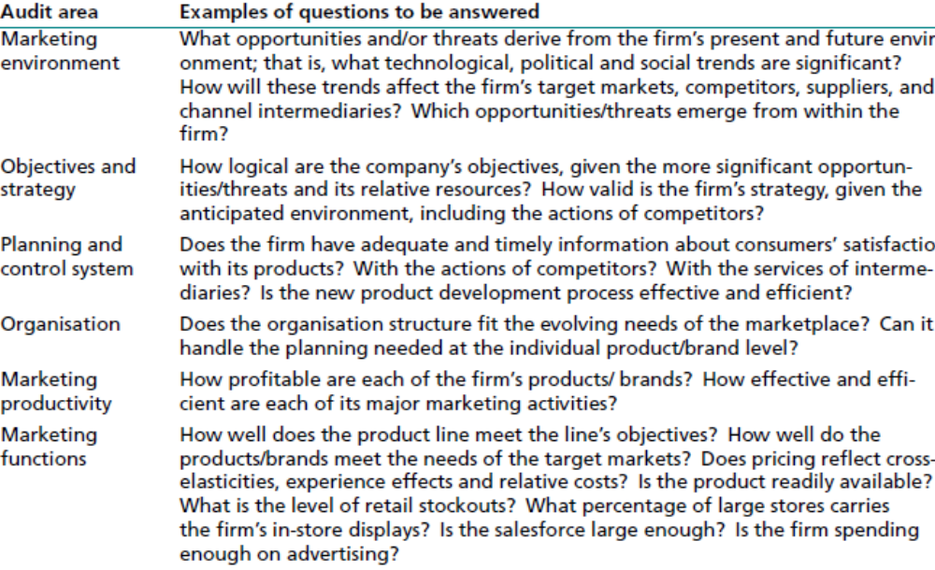
Types of Audits
and strategy, planning and control systems, organisation, productivity, and individual marketing activities such as sales and advertising.

